Slide 1


Texture Mapping
CS 418: Interactive Computer Graphics
UNIVERSITY OF ILLINOIS AT URBANA-CHAMPAIGN
Eric Shaffer

Slide 2
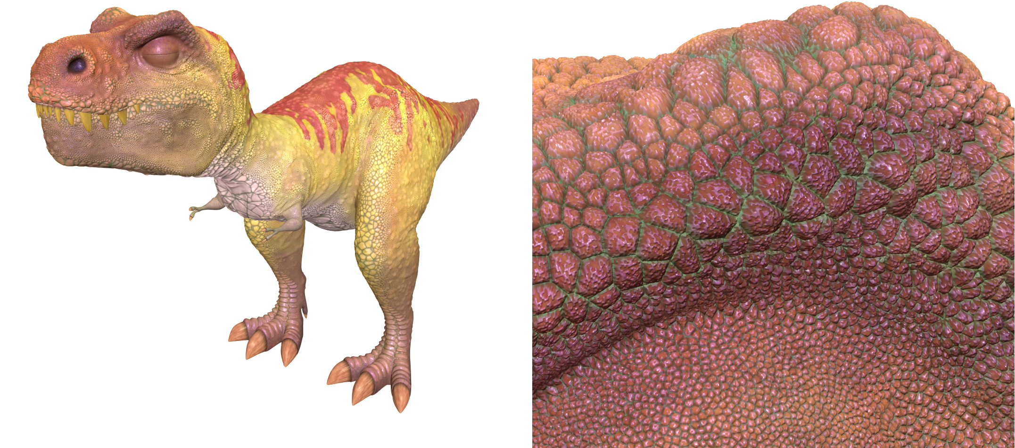
The Limits of Geometric Modeling
Graphics cards can render over 20 billion polygons per second (NVIDIA 2080 TI in 2018)
That number is still insufficient for many visual phenomena
Consider rendering a herd of 100s of bumpy-skinned dinosaurs

Slide 3
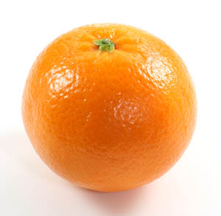
Or Consider Modeling an Orange
Start with an orange-colored sphere
Too simple
Replace sphere with a more complex shape
Does not capture surface characteristics (small dimples)
Takes too many polygons to model all the dimples

Slide 4
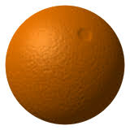
Modeling an Orange
Take a picture of a real orange
“paste” pixels of the image onto simple geometric model
This process is known as texture mapping
Specifically image texturing
Still might be problematic…
Looking at the orange in a rendered scene
How could you tell the colors on the orange aren’t generated by shading?

Slide 5
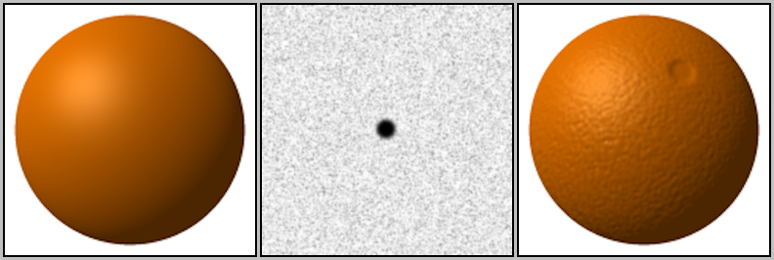
Modeling an Orange
Another alternative would be bump mapping
Use an image that specifies the normal to use to shade the surface
This way, can render an “bumpy” surface during shading
Without modeling the bumpy surface with lots of triangles

Slide 6
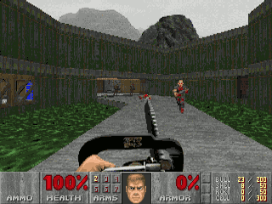
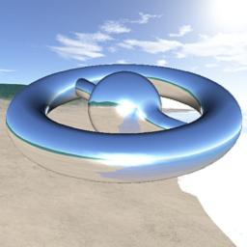
Some Types of Texture Mapping
Image Texturing
Uses images to fill inside of polygons
Environment Mapping
Uses a picture of the environment for texture maps
Allows simulation of mirror-like surfaces
Bump mapping
Alters normal vectors during the rendering process
Generates a bumpy looking surface

Slide 7
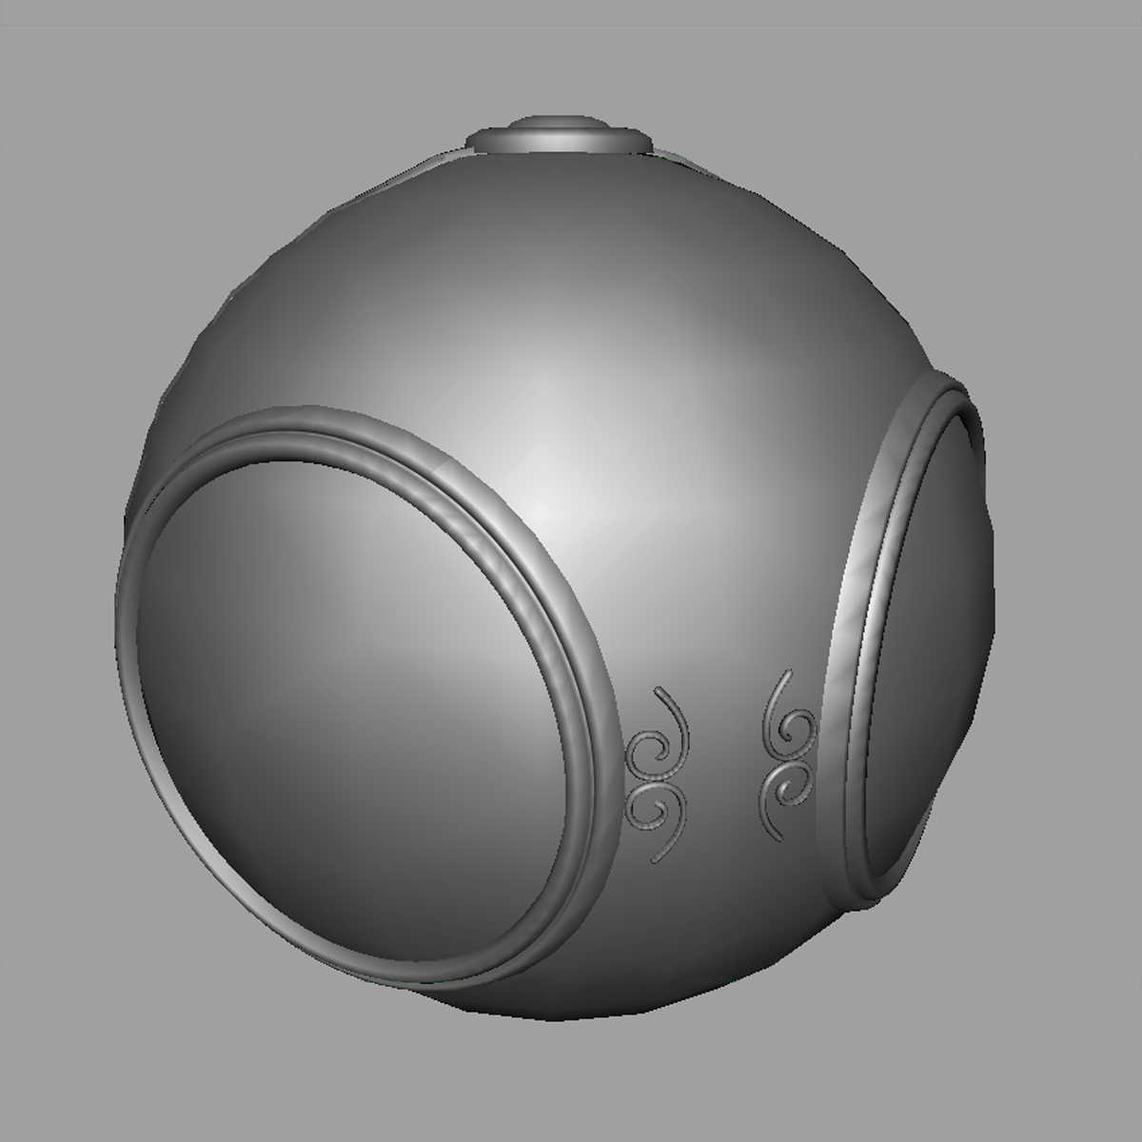

Image Texturing
geometric model
texture mapped

Slide 8
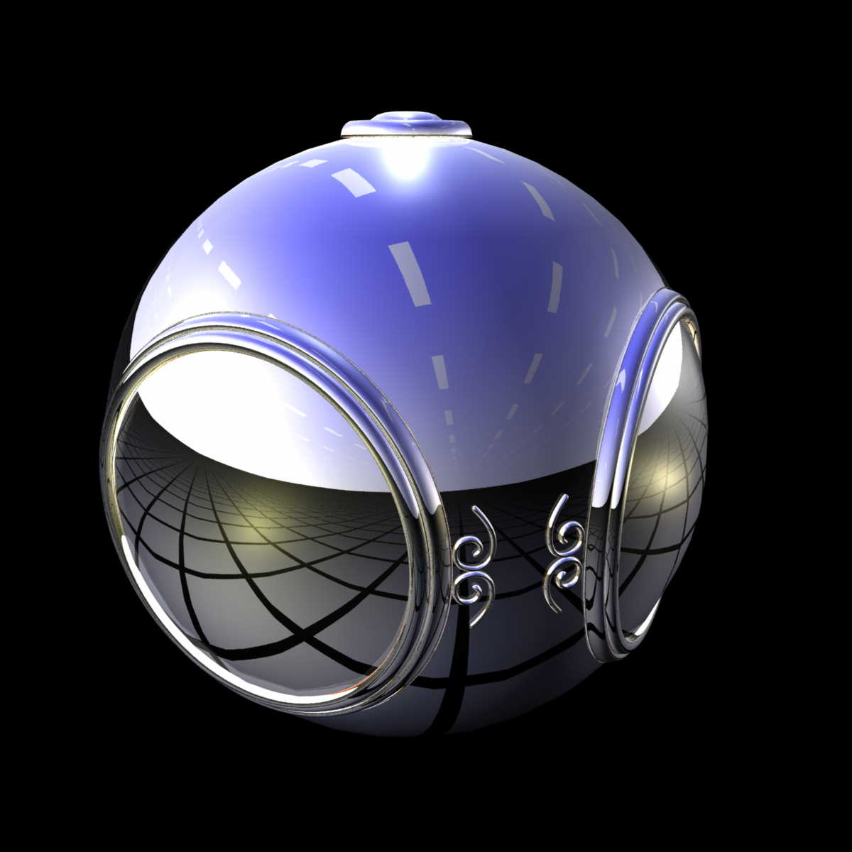
Environment Mapping

Slide 9
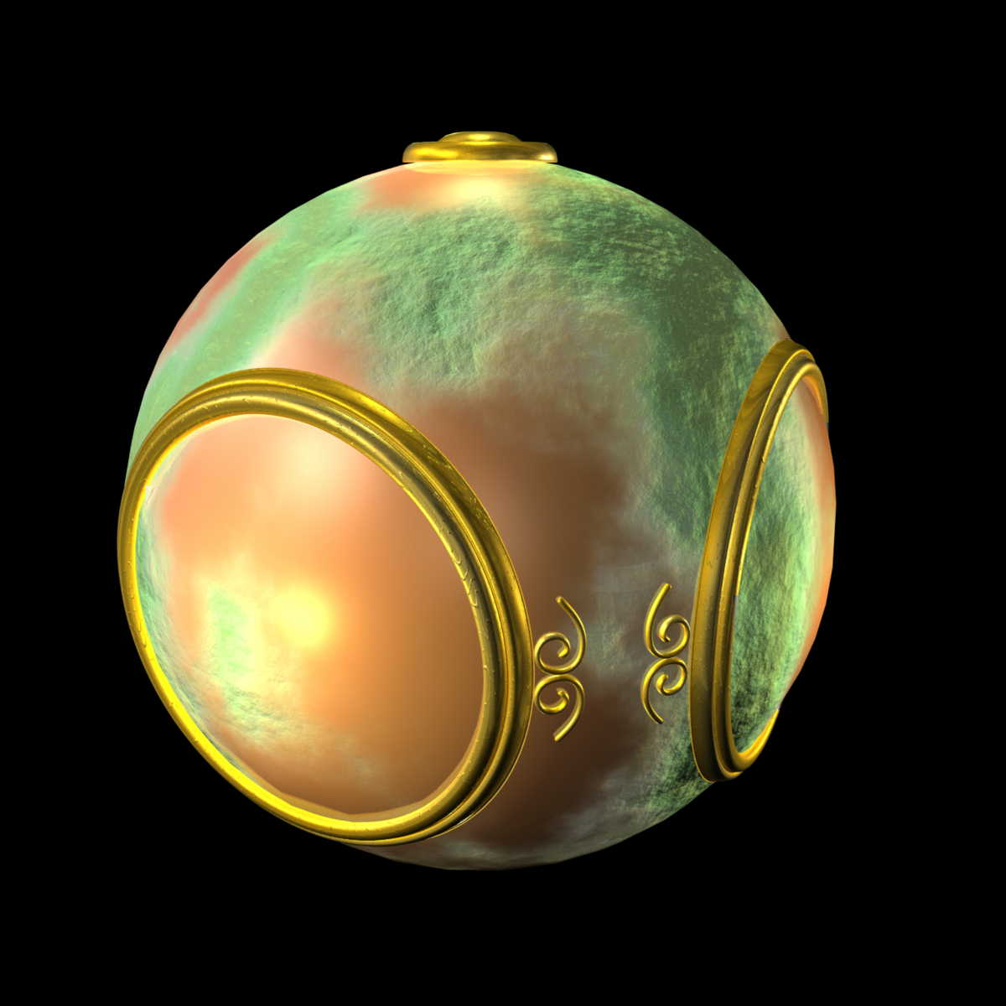
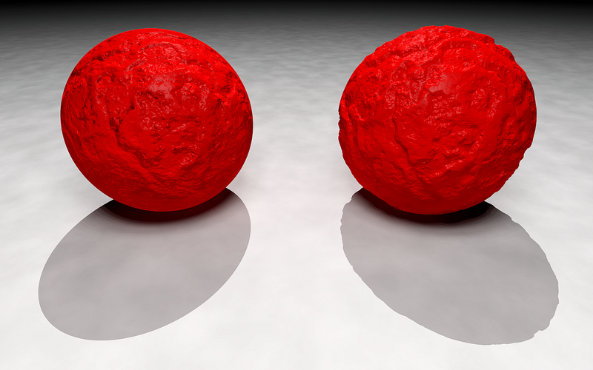
Bump Mapping

Slide 10
So What is Texture?
A surface’s texture is its look and feel—just think of the texture of an oil painting. In computer graphics, texturing is a process that takes a surface and modifies its appearance at each location using some image, function, or other data source. As an example, instead of precisely representing the geometry of a brick wall, a color image of a brick wall is applied to a rectangle, consisting of two triangles. When the rectangle is viewed, the color image appears where the rectangle is located. Unless the viewer gets close to the wall, the lack of geometric detail will not be noticeable.
-- Akenine-Moeller, Tomas; Haines, Eric; Hoffman, Naty. Real-Time Rendering, Fourth Edition

Slide 11
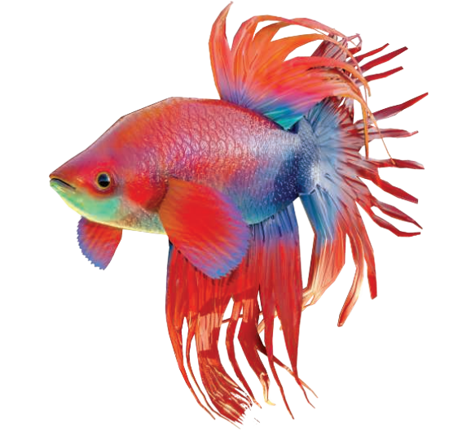
For example
Both image texturing and bump mapping are used here

Slide 12
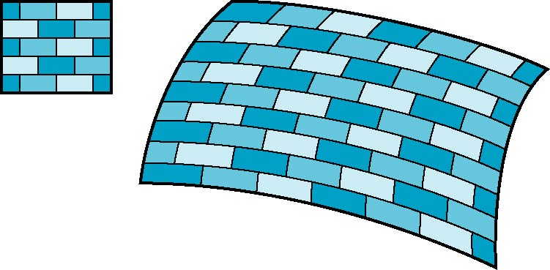
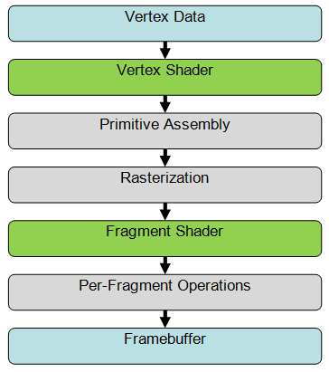
Texturing Mapping and the Pipeline
2D image
3D surface
In the simplest form texture mapping is a process in which
a fragment on a surface to be rendered
is mapped to a color in a texture (an image)
and then this color (called a texel) is used in shading
Mapping is implemented in the fragment shader
Efficient because few polygons make it past the clipper

Slide 13

Texture Mapping
Mapping means we need a function
Given a point on a surface (a fragment)
We want to know to which texel in the texture it corresponds to
Need a map of the form
s = s(x,y,z)
t = t(x,y,z)
y
z
x
geometry
display
We will use the word texel to indicate a pixel in the texture image…so it doesn’t get confused with a pixel in our final rendered image
t
image
s

Slide 14
Specifying a Texture Mapping Function
You need to come up with a mapping from surface vertices → texture space
Specify mapping using (u,v) vertex attributes
The (u,v) coordinates map into a parametric texture space
Generally (u,v) is in [0,1] x [0, 1]
We can allow coordinates to go outside that range...
if we tell WebGL how to handle that event …more on that later

Slide 15
A Word About Coordinates
We will use the following conventions
(u,v) are the texture coordinates in the parametric space
Typically in [0,1]x[0,1]
(s,t) are the texel coordinates
For example in a 32x32 image (s,t) would be in [0,31]x[0,31]
(s,t) are floating point coordinates…
…we may not map directly onto an integer texel location
…and then we need to figure out how to choose the best texel
Some websites/books/posts use (s,t) to denote parametric coordinates…so be aware….

Slide 16
Mapping a Texture
Based on parametric texture coordinates
Specify as a 2D vertex attribute
Texture Space
Object Space
v
1, 1
(u, v) = (0.2, 0.8)
0, 1
A
a
c
(0.4, 0.2)
b
B
C
0, 0
1, 0
u
(0.8, 0.4)

Slide 17
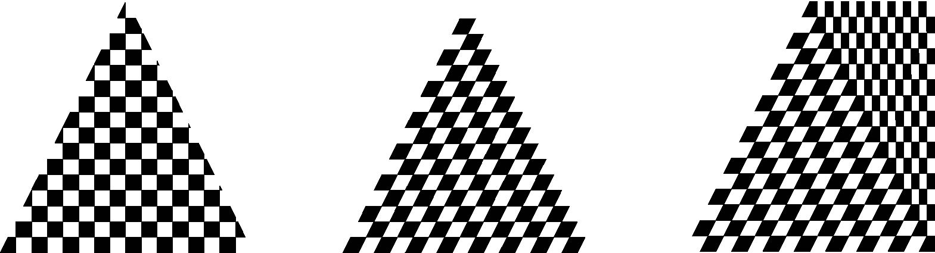
Mapping a Texture
Can be distortions
texture stretched
over trapezoid
showing effects of
bilinear interpolation
good selection
of tex coordinates
poor selection
of tex coordinates

Slide 18
Basic Steps in WebGL
Three steps to applying a texture
specify the texture
read or generate image
assign to texture
enable texturing
assign texture coordinates to vertices
proper mapping function is left to application
specify texture parameters
wrapping, filtering

Slide 19
Specifying a Texture Image
Define a texture image from an array of texels (texture elements) in CPU memory
Use an image in a standard format such as JPEG
Scanned image
Generate by application code
WebGL supports only 2 dimensional texture maps
no need to enable as in desktop OpenGL
desktop OpenGL supports 1-4 dimensional texture maps

Slide 20
Define Image as a Texture
gl.texImage2D( target, level, components, w, h, border, format, type, texels );
target: type of texture, e.g. GL_TEXTURE_2D
level: used for mipmapping (discussed later)
components: elements per texel
w, h: width and height of texels in pixels
border: used for smoothing (discussed later)
format and type: describe texels
texels: pointer to texel array

Slide 21
Example
Once the image data is loaded into an array
We’ll discuss how to do that in a future lecture
You then need to tell WebGL the image is a texture
WebGL has a concept of the current texture
gl.bindTexture sets the current texture
this is the texture that gets operated on
function handleLoadedTexture(texture) {
gl.bindTexture(gl.TEXTURE_2D, texture);
gl.pixelStorei(gl.UNPACK_FLIP_Y_WEBGL, true);
gl.texImage2D(gl.TEXTURE_2D, 0, gl.RGBA, gl.RGBA, gl.UNSIGNED_BYTE, texture.image);
gl.texParameteri(gl.TEXTURE_2D, gl.TEXTURE_MAG_FILTER, gl.NEAREST);
gl.texParameteri(gl.TEXTURE_2D, gl.TEXTURE_MIN_FILTER, gl.NEAREST);
gl.bindTexture(gl.TEXTURE_2D, null);
}

Slide 22
Example
When the image data is given to WebGL you tell it how to “unpack” it
Here, we tell it to flip the image vertically
Most image formats increase coords going down vertical axis
WebGL expects the coordinates to increase going up
function handleLoadedTexture(texture) {
gl.bindTexture(gl.TEXTURE_2D, texture);
gl.pixelStorei(gl.UNPACK_FLIP_Y_WEBGL, true);
gl.texImage2D(gl.TEXTURE_2D, 0, gl.RGBA, gl.RGBA, gl.UNSIGNED_BYTE, texture.image);
gl.texParameteri(gl.TEXTURE_2D, gl.TEXTURE_MAG_FILTER, gl.NEAREST);
gl.texParameteri(gl.TEXTURE_2D, gl.TEXTURE_MIN_FILTER, gl.NEAREST);
gl.bindTexture(gl.TEXTURE_2D, null);
}

Slide 23
Example
We can give WebGL hints about how to scale the image data
Need to magnify if we have lots of fragments and few texels
Need to minify if we have few fragments and lots of texels
function handleLoadedTexture(texture) {
gl.bindTexture(gl.TEXTURE_2D, texture);
gl.pixelStorei(gl.UNPACK_FLIP_Y_WEBGL, true);
gl.texImage2D(gl.TEXTURE_2D, 0, gl.RGBA, gl.RGBA, gl.UNSIGNED_BYTE, texture.image);
gl.texParameteri(gl.TEXTURE_2D, gl.TEXTURE_MAG_FILTER, gl.NEAREST);
gl.texParameteri(gl.TEXTURE_2D, gl.TEXTURE_MIN_FILTER, gl.NEAREST);
gl.bindTexture(gl.TEXTURE_2D, null);
}

Slide 24
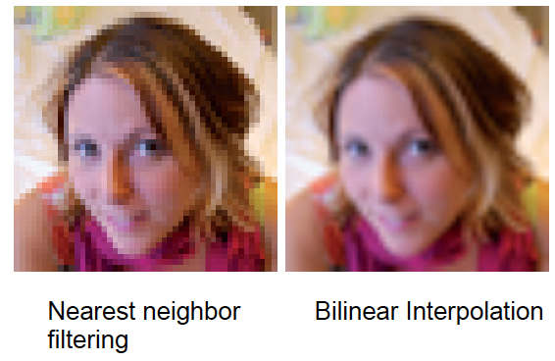
Examples

Slide 25
Magnification: Nearest Neighbor

Slide 26
Magnification: Bilinear Interpolation
In bilinear interpolation, we estimate a value for a function
On a 2D grid…with function samples at the grid vertices
We interpolate first in one direction (e.g. the x direction)
Interpolate using linear interpolation twice
Find 2 points…one on each edge
Then interpolate in the other direction (e.g. the y direction)
Linear interpolation again
Between the two points from the first round of interpolation

Slide 27
Magnification: Bilinear Interpolation

Slide 28
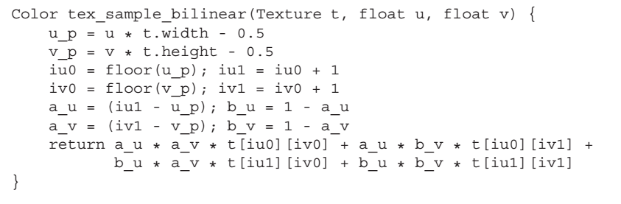
Bilinear Filtering
In C/C++ style code a function to do bilinear filtering would look like this:

Slide 29
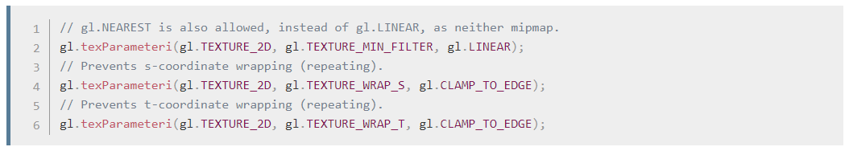
Out of Bound (u,v) Coordinates
We can let (u,v) coordinates be outside the range [0,1]
Yes…they can even be negative
How these coordinates are handled is defined by the Wrap Mode
WebGL supports three wrap modes in both the s and t coordinates:
REPEAT
CLAMP_TO_EDGE
MIRRORED_REPEAT
Example:

Slide 30
Repeat

Slide 31
Clamp

Slide 32
Mirrored Repeat

Slide 33
Sprites versus Textures
Where do you see sprites being used?
Where do you see textures being used?
What is the difference?

